Slide 1

SALES ANALYSIS PROJECT: POWERBI DASHBOARD
RAMYA KRISHNAN A
ramyaarul192001@gmail.com
16-05-2024

Slide 2
INTRODUCTION
Welcome to the Sales Analysis Project! Our goal is to analyze sales performance across cities, sites, and target segments, integrating operational metrics to optimize strategies and maximize revenue. Through data visualization and analysis, we aim to provide actionable insights for informed decision-making and sustainable growth. Let's explore the potential of sales data together!

Slide 3
PROBLEM STATEMENT
To leverage sales performance data across various cities, sites, and target segments, alongside relevant operational metrics such as store start dates, synchronization times, and backup completion times. The objective is to identify correlations between sales performance and operational efficiency, enabling the optimization of sales strategies and revenue maximization.

Slide 4

DASHBOARD

Slide 5
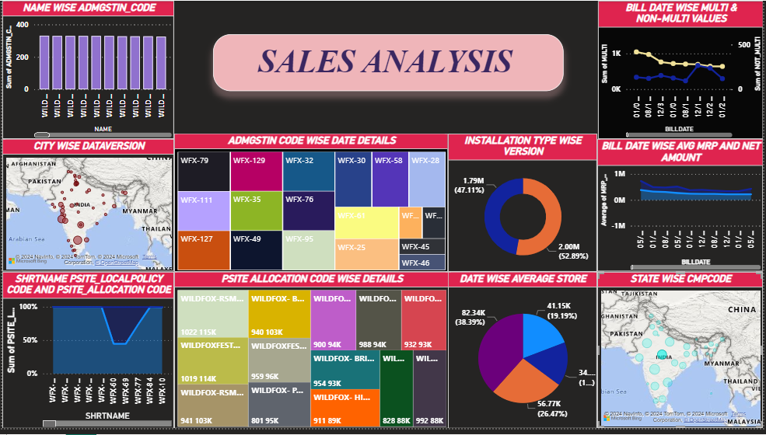

Slide 6
BAR CHART (NAME WISE ADMGSTIN CODE):
Displays ADMGSTIN codes categorized by name.
Tooltip shows the name and ADMGSTIN code when hovered over.

Slide 7
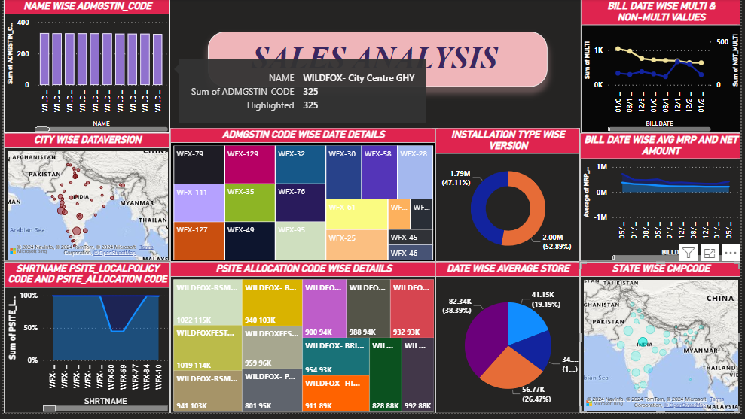

Slide 8
GEO MAP (CITY WISE DATAVERSION):
Illustrates data version usage across different cities.
Tooltip displays the city name and data version when hovered over.

Slide 9
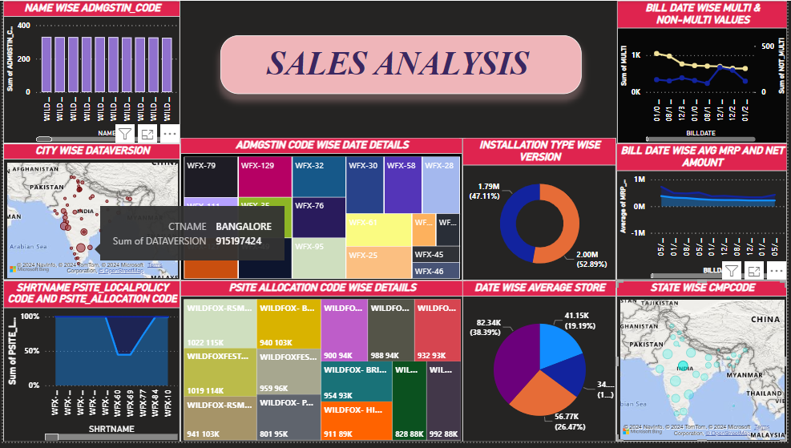

Slide 10
STACKED AREA CHART (SHRTNAME WISE PSITE LOCAL POLICY CODE AND PSITE ALLOCATION CODE):
Visualizes PSITE local policy code and allocation code trends categorized by SHRTNAME.
Tooltip shows SHRTNAME and the sum of each code separately when hovered over.

Slide 11
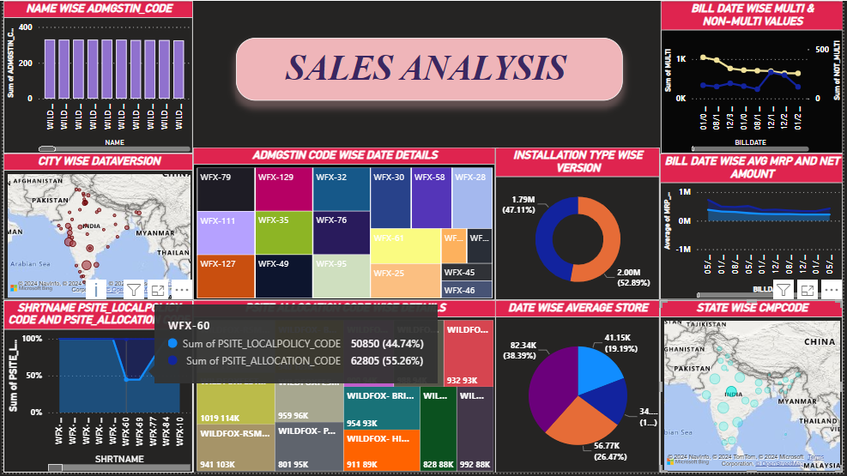

Slide 12
TREE CHART (ADMGSTIN CODE WISE DATE DETAILS):
Presents date details for each ADMGSTIN code.
Tooltip displays all dates associated with the selected ADMGSTIN code.

Slide 13
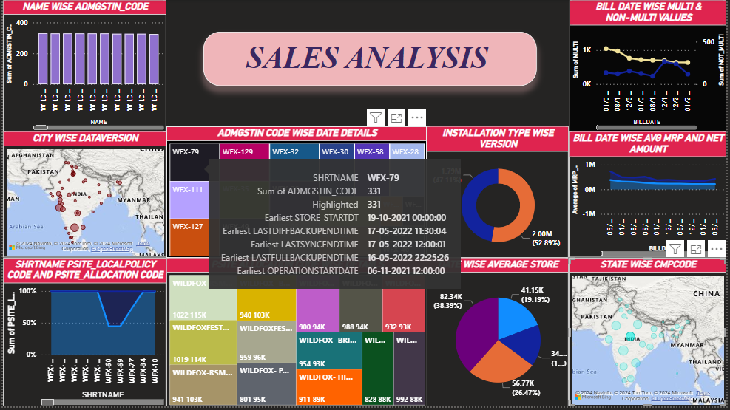

Slide 14
TREE CHART (PSITE ALLOCATION CODE WISE DETAILS):
Provides details such as name, email, city, and website for each PSITE allocation code.
Tooltip shows all details related to the selected PSITE allocation code.

Slide 15
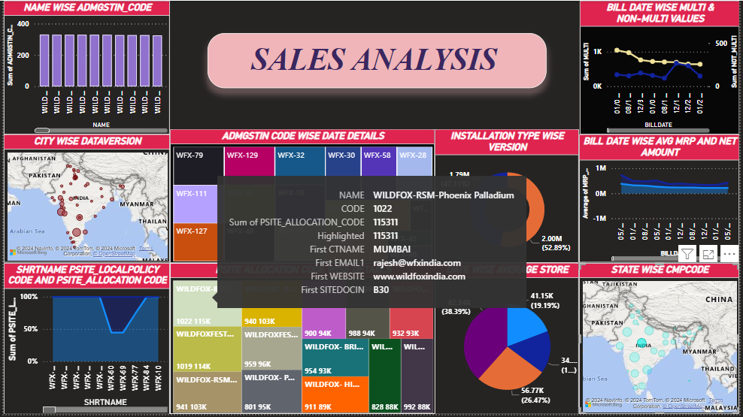

Slide 16
PIE CHART (DATE WISE AVERAGE STORAGE):
Represents the average storage usage for each date.
Tooltip displays the year-wise average storage when hovered over.

Slide 17
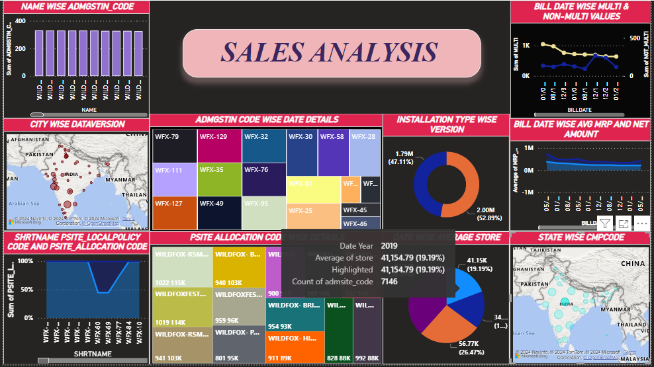
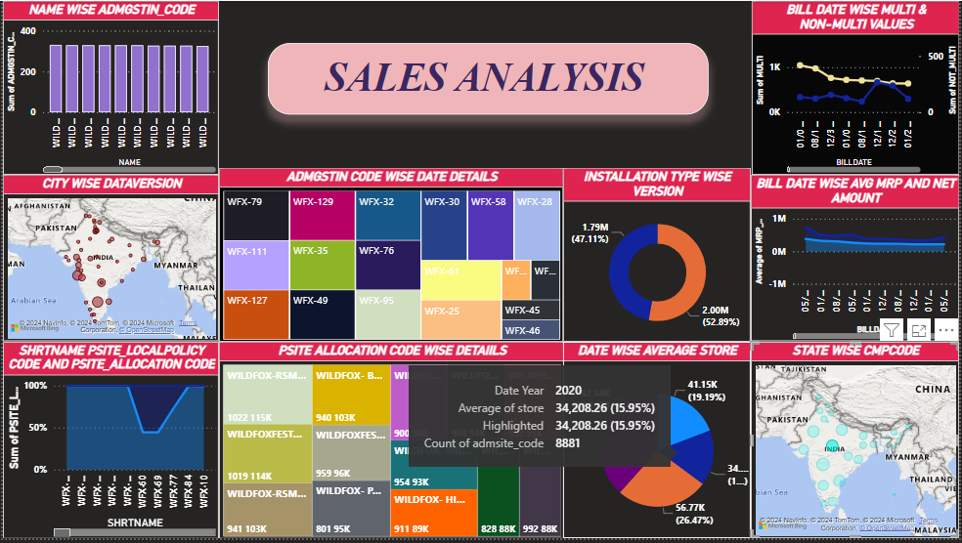

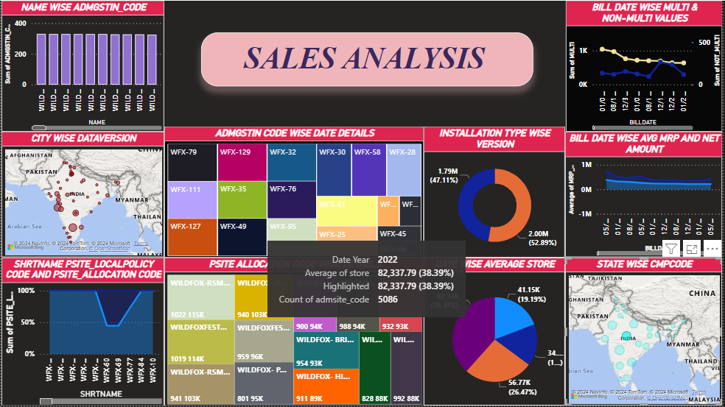

Slide 18
DONUT CHART (INSTALLATION TYPE WISE VERSION):
Shows the distribution of installation types for each version.
Tooltip reveals which installation type is predominantly used for a particular version.

Slide 19
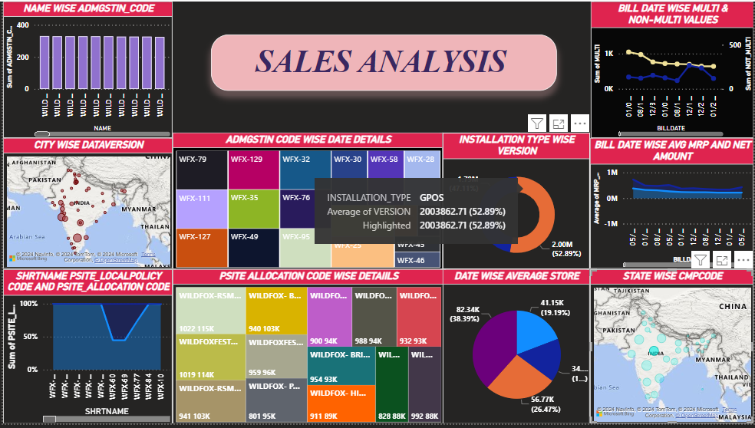


Slide 20
LINE CHART (BILL DATE WISE MULTI AND NON-MULTI VALUES):
Visualizes multi and non-multi values over time, categorized by bill date.
Tooltip shows all details related to the selected bill date.

Slide 21
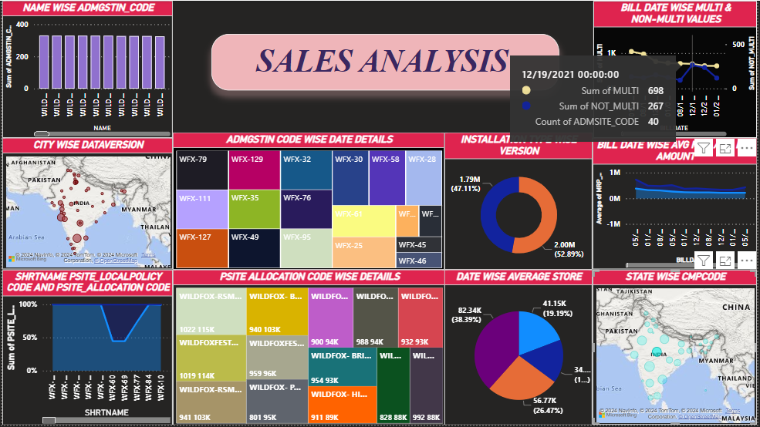

Slide 22
STACKED AREA CHART (BILL DATE WISE AVG AND NET AND MRP VALUES):
Illustrates trends in average, net, and MRP values over time, categorized by bill date.
Tooltip shows detailed information for each bill date, including the average amount of NET value and the average amount of MRP value when hovered over.

Slide 23
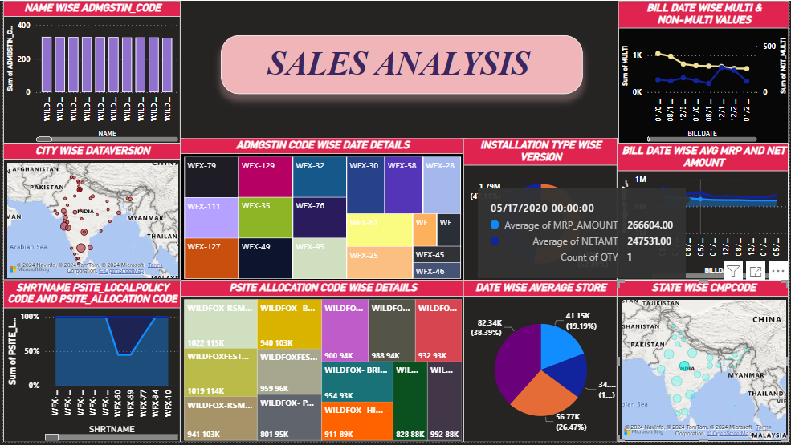

Slide 24
GEO MAP (STATE WISE CMPCODE):
Displays CMPCODEs categorized by state.
Tooltip shows detailed information including city, state, code, STD code, etc., when hovered over.

Slide 25
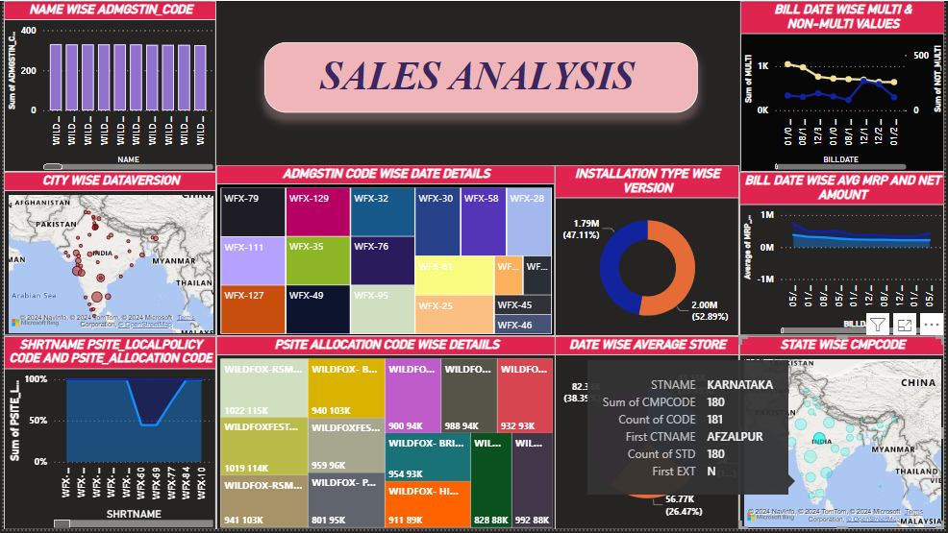

Slide 26
CONCLUSTION
In summary, our Sales Analysis Project has provided actionable insights to optimize sales strategies and maximize revenue. Through dynamic visualizations and data exploration, we've uncovered key trends and correlations, empowering informed decision-making. As our project moves forward, these insights will serve as a foundation for growth and operational excellence in the dynamic marketplace.

Slide 27


